Slide 1
STAT 50
Section 6.5
Large-Sample Tests for the difference Between Two Means

Slide 2































Slide 3

























Slide 4



Slide 5

























Slide 6






















Slide 7


























Slide 8






























Slide 9








































Slide 10
















Slide 11














































Slide 12





































































Slide 13
























































Slide 14
An electrical engineer wishes to compare the mean lifetimes of two types of transistors in an application involving high-temperature performance. A sample of 60 transistors of type A were tested and were found to have a mean lifetime of 1819 hours and a standard deviation of 165 hours. A sample of 120 transistors of type B were tested and were found to have a mean lifetime of 1658 hours and a standard deviation of 215 hours.
Using a test of hypotheses, can you support the claim that the mean lifetime of type A transistors exceeds the mean lifetime of type B transistors by at least 125 hours? Report a P-value and state your conclusion in context.

Slide 15
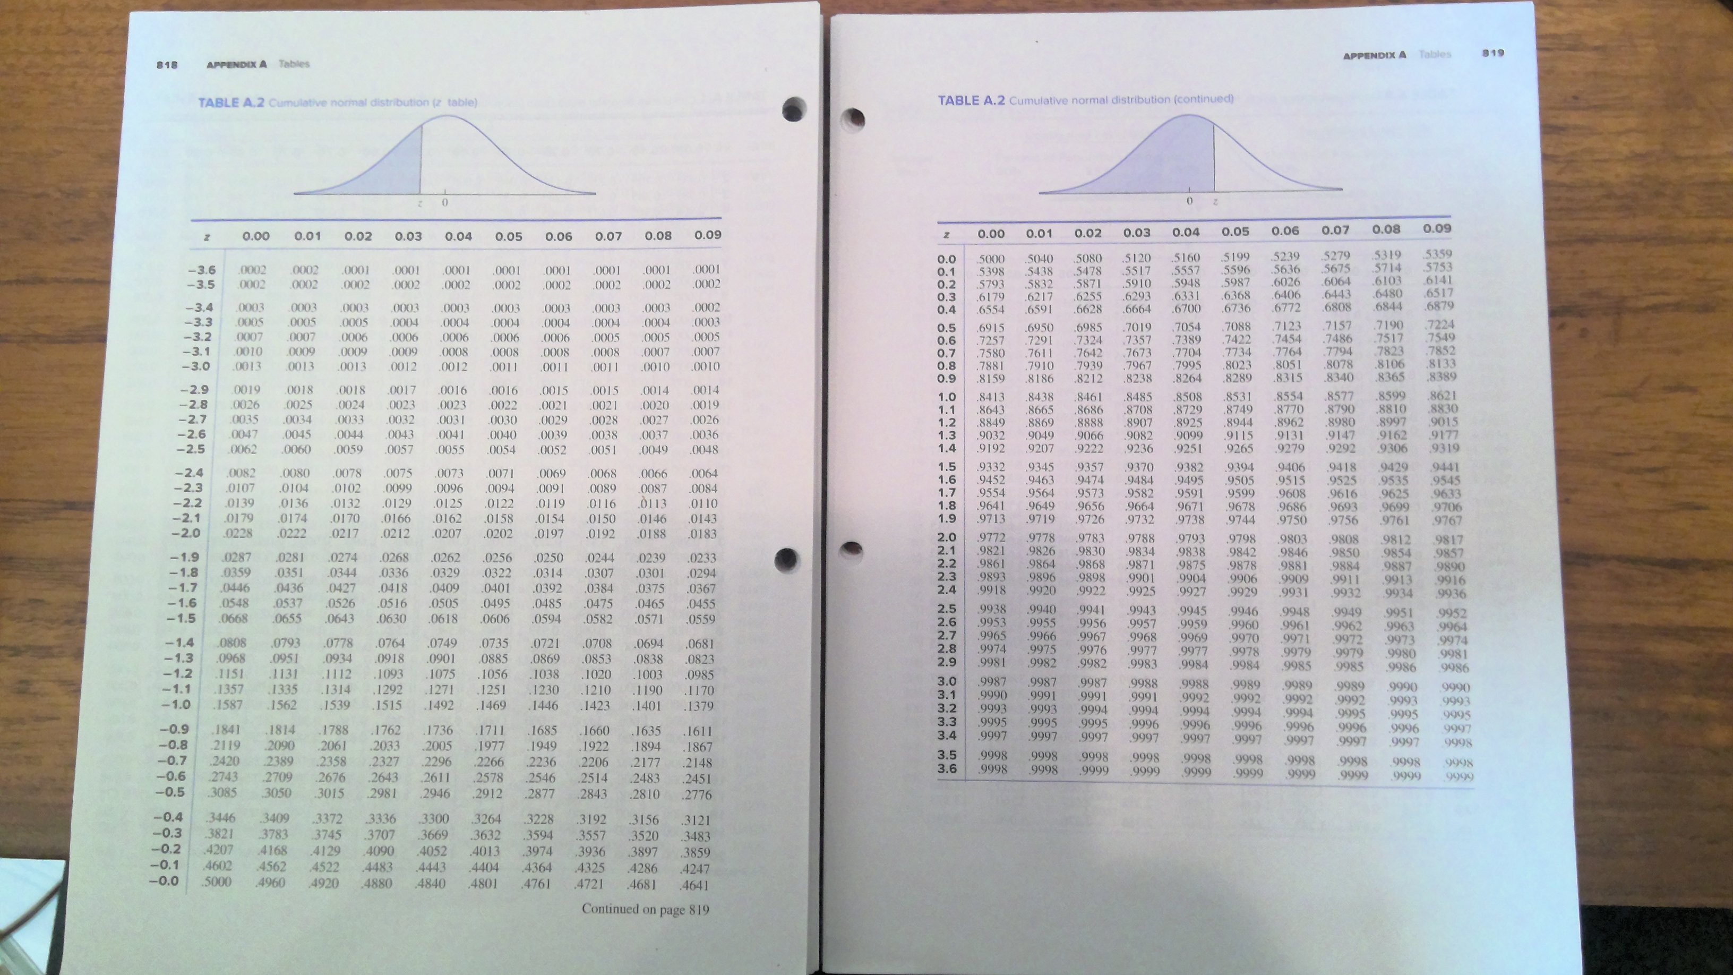

Slide 16
















Slide 17

























































Slide 18


















Slide 19
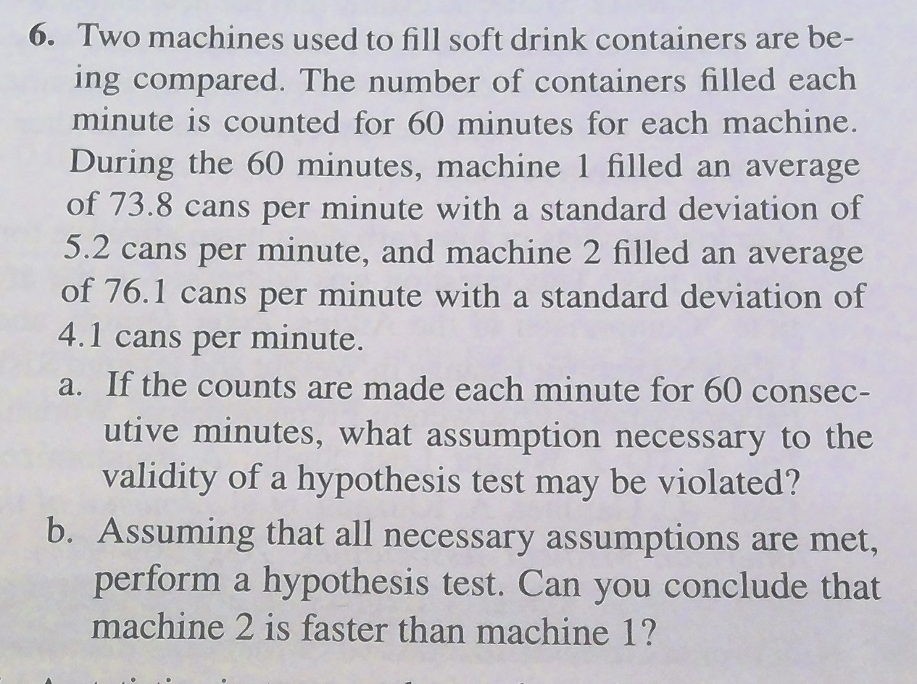


Slide 20












Slide 21













Slide 22




















